Slide 1
The Modulo

Slide 2
Review On Operators
Basic Math Operators
+ (add)
- (minus)
/ (divide)
* (multiply)
= (sets a value to variable)
Follow order of precedence
We also have conditional operators
Will cover this again.

Slide 3

Reminder - Integer Division
You may have realized
int val = 5 / 6; // sets val to 0
int val2 = 10 / 3; // sets val2 to 3
You loose the decimal point
Truncates, does not round!
This is a very, very common thing
both to our advantage
and often to our error
This Photo by Unknown Author is licensed under CC BY-NC-ND

Slide 4
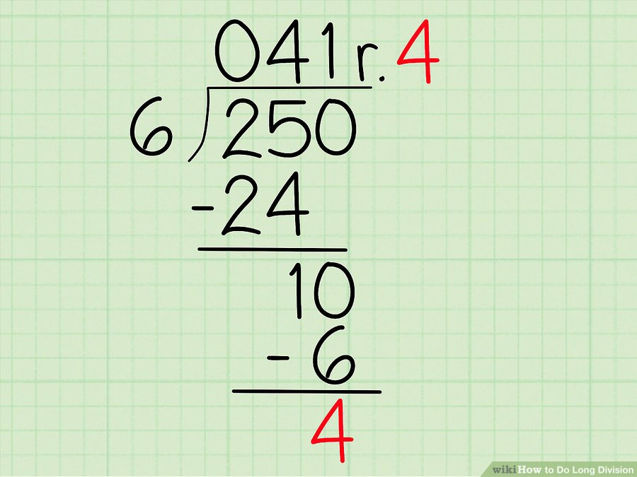
Modulo - Extremely useful operation
modulo (%) gives you the remainder
4th grade math!
This example: int x = 250 % 6; // would be 4 So combining them int whole = 250 / 6; //41 int remainder = 250 % 6; // 4

Slide 5

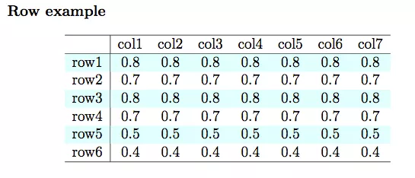
What are some cases to use it?
Forming groups
The remainder is always between 0 and n-1
Value % 6 has a range of 0-5
Value % 4 has a range of 0-3
Think about rolling dice
Math.random() % 6; - random number between 0 and 5
Determining Even and Odd - Math.random() %2 - if 0, even, if 1, odd
Pro Tip
Adding a remainder operator, allows us to handle complex math like GCD, and others.

Slide 6
Convenience Operators
We often find ourselves doing things like
int value = 100
value = value + 10;
Introducing operator plus assignment
int value += 10; // same as value = value + 10;
+=
-=
/=
*=
%=
We also like to add and subtract by 1
--value and ++value
value++ and value—
Will go into the differences on these later
Examples:
int value = 100;
value++; // value is now 101
value += 10; // value is now 111
value /= 10; // value is now 11
value *= 2; // value is now 22
--value; // value is now 21
value %= 20; // value is now 1

